Slide 1
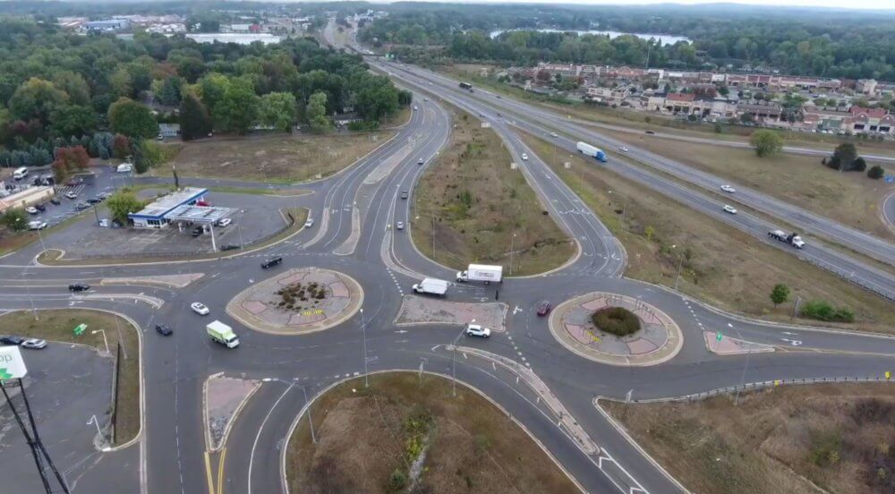
Movement-Based Safety Performance Functions
NCDOT Project 2022-13 Closeout Meeting
Chris Cunningham, PE
Ishtiak Ahmed
Richard Thomas Chase
James Poslusny
Kyra Stash
May 17, 2024

Slide 2
Background
NCDOT RP 2018-20: Reasonable Alternatives for Grade-Separated Intersections
Limited dataset (35)
  21 Conventional
  11 RCUT
  3 DDI
Only used conflict point type and 24h movement volumes
Model was tested by NCDOT against 300+ Charlotte conventional intersections

Slide 3
Safety Analysis - Methodology
Model Estimation Process
In addition to the classified CP/NCP crashes, the conflicting movement volumes (CMVs), CP types (cross/merge/diverge), and AADT data should be collected for model estimation.
Crash Data
Intersection Crash Frequency and Severity
Travel Directions of Related Vehicles
Vehicle Maneuvers of Related Vehicles
Crash Classification
Conflict Movement Volumes (CMVs)
= ∑AADT x TM (%)
CP Crashes
Frequency
Severity
CP Types
Crossing
Merging
Diverging
NCP Crashes
Frequency
Severity
AADT Data
Major AADT
Minor AADT
Model Estimation
Model Estimation
CP-SPF
NCP-SPF

Slide 4
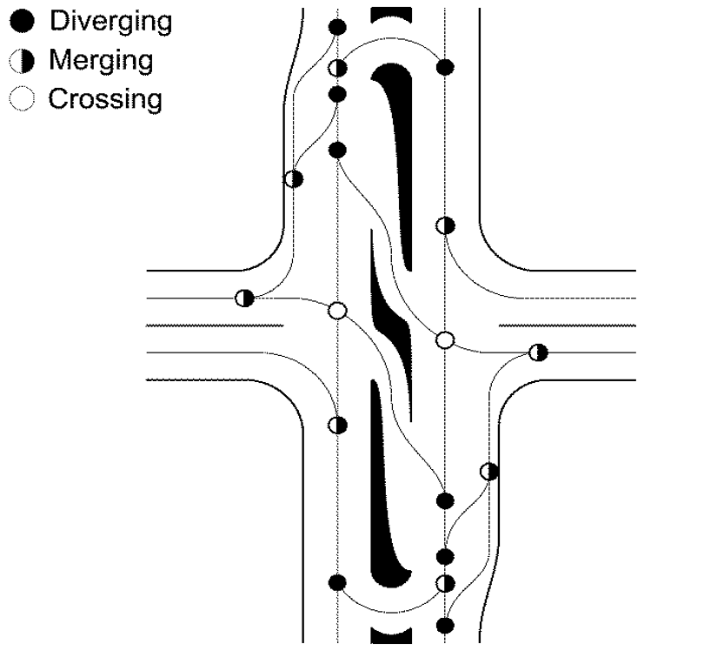


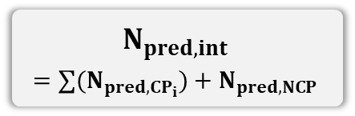
Safety Analysis - Methodology
Model Application Process
In the applications, the CP- and NCP-SPFs predict the crashes separately, and then the predicted crashes are aggregated to the intersection-level total crashes.
CP-SPF
NCP-SPF
Predict
Predict
$$N_{pred,int}$$
$$=∑(N_{pred,CP_{i}})+N_{pred,NCP}$$
$$N_{pred,CP_{i}}$$
$$N_{pred,NCP }$$
CMV_{Minor}
AADT_{Major}
CMV_{Major}
AADT_{Minor}
Merging CP

Slide 5
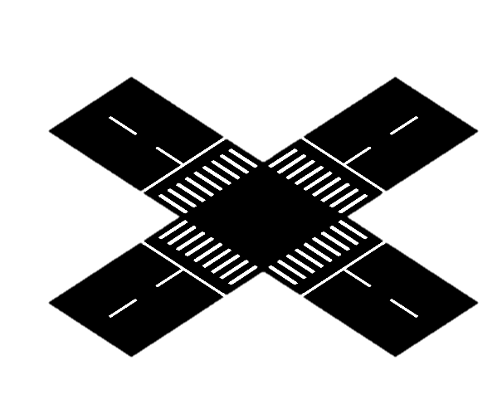
Safety Analysis - Methodology
Conflicting Movement Volumes (CMVs)
The CMVs are the two movement AADTs passing a conflict point
Like the traditional SPF, the CP-SPF uses major & minor CMVs as exposures
The major and minor CMVs are determined as follows.
- Higher volume = Major CMV
- Lower volume = Minor CMV
Traditional SPF
Concept of CMVs
Major AADT
Minor AADT
Conceptually
Similar
Movement B
Conflict Point
Movement A
Intersection

Slide 6
Data Collection: Variables
Movement Volumes
Number and Type of Lanes
Posted Speed Limit
Relative Angle between movements
Traffic Control (Lefts)
Lateral Offset (Lefts)
RT Channelization
RTOR Allowed

Slide 7
Predictor name | Type | Distribution | Potential use in model(s)
1. Movement-based volume | Numerical | - | All
2. Number of lanes by movement | Numerical | - | Crossing, merge, and diverge
3. Type of lane by movement | Categorical | All exclusive: 50% All shared: 39% Mix of shared and exclusive: 11% | Crossing, merge, and diverge
4. Posted speed limit | Numerical | - | All
5. Relative angle between two crossing movements | Categorical | Base: 81% Acute: 9% Obtuse: 10% | Crossing and merge
6. Left-turn control type | Categorical | Protected: 42% Permissive: 34% Protected-permissive: 24% | Crossing and merge
7. Left-turn lateral offset | Categorical | Base: 35% Positive: 21% Negative: 44% | Crossing
8. Right-turn channelized? | Categorical | Yes: 5% No: 95% | Merge and diverge
9. Right-turn on red allowed? | Categorical | Yes: 99% No: 1% | Merge and diverge

Slide 8
Discussions
Crash Data Analysis Difficulties
  Skewed Intersections
  Non-Cardinal Intersections
  Multivehicle (3+)
  Turn bay-adjacent crashes (left or right)
Excluding sites and individual crashes vs. categorizing NCP
  Driveways
  Bike-Ped involved
  U-turns
  Lack of narrative detail for movement assignment

Slide 9
Non-Cardinal Intersections
Cardinal
Non-Cardinal

Slide 10
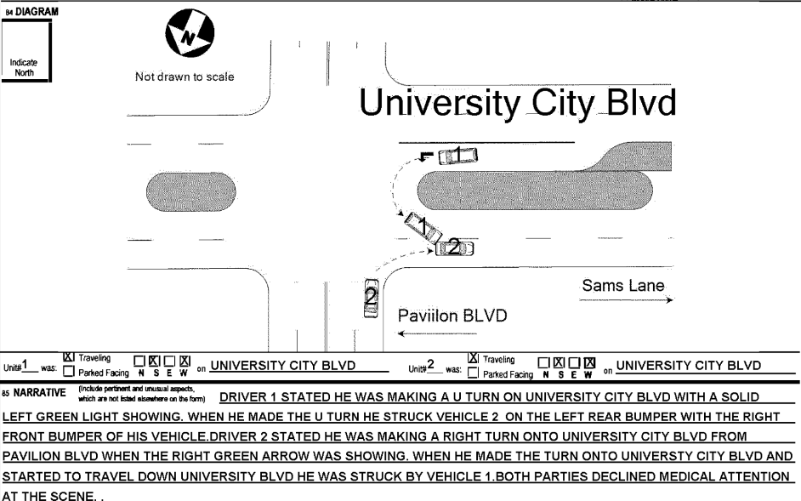
U-Turn Movements

Slide 11
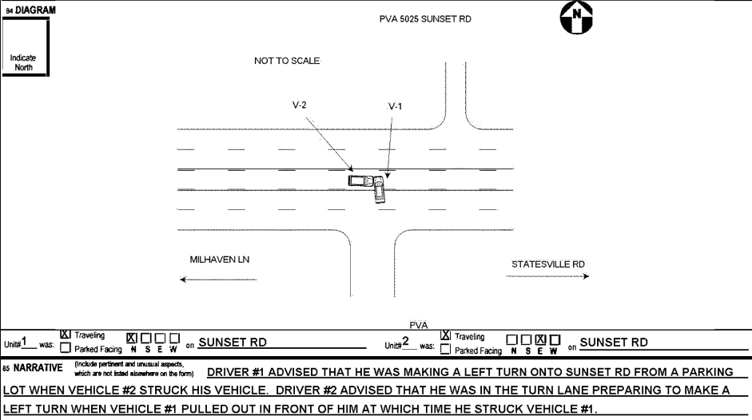
Driveways

Slide 12
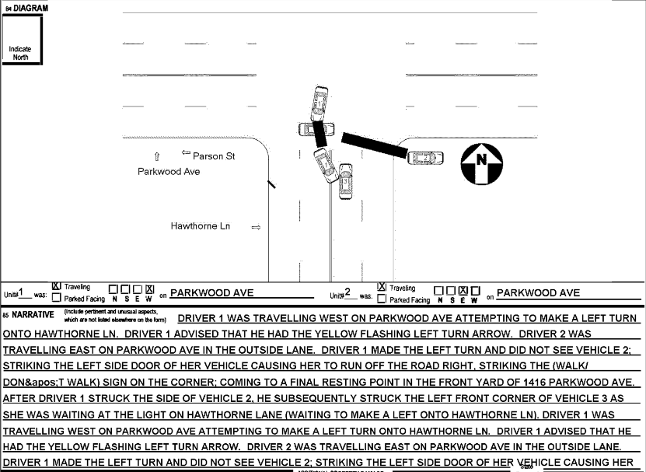
3+ Vehicles

Slide 13
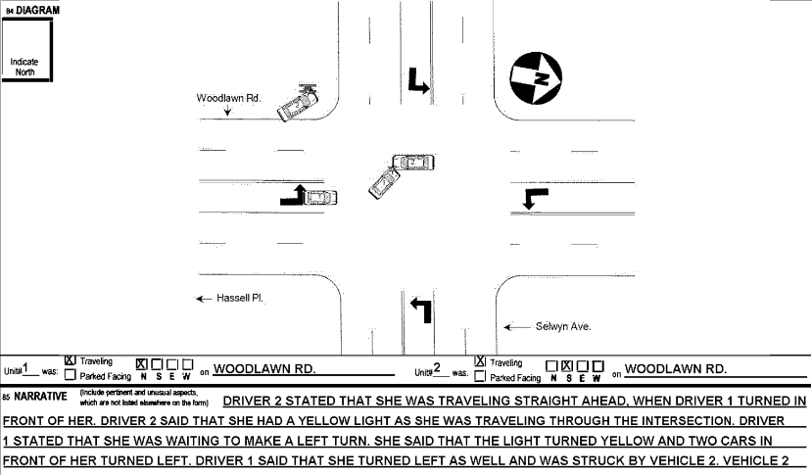
N/S Misaligned in Crash Diagram

Slide 14
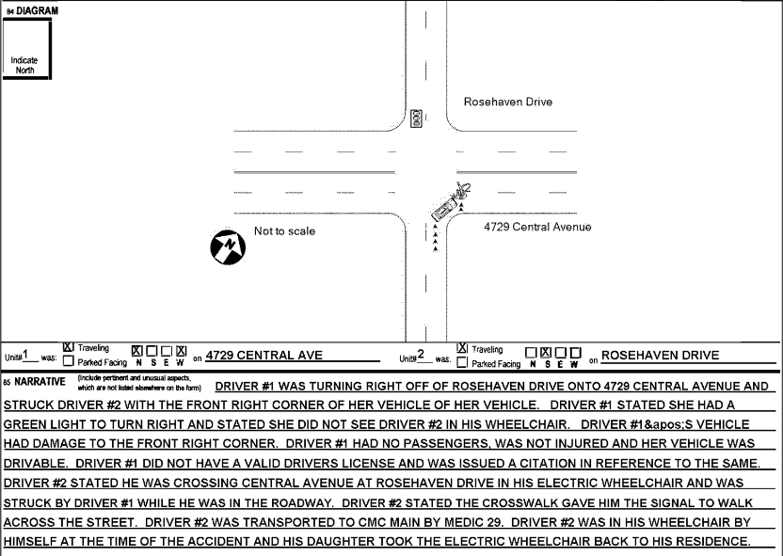
Pedestrian Crash

Slide 15
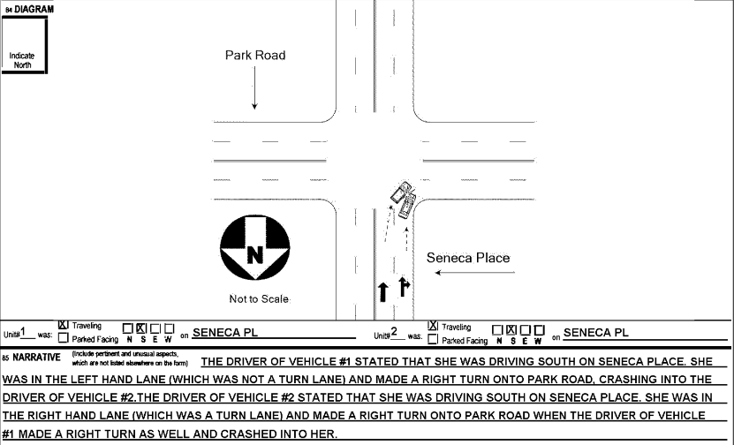
Incorrect use of lanes

Slide 16
Methodology – Predictive Models
Negative Exponential (Poisson)
Negative Binomial
Hurdle Model

Slide 17
NCP Models – Total Crashes
Variable | Estimate | P Value
Intercept | -11.4529 | <0.01
log(MajorVol) | 0.86102 | <0.01
log(MinorVol) | 0.50789 | <0.01
Max PSL > 35 mph | 0.16251 | <0.05
AIC = 1652
Variable | Estimate | P Value
Intercept | -12.25 | <0.01
log(MajorVol) | 0.93737 | <0.01
log(MinorVol) | 0.52196 | <0.01
AIC = 1654

Slide 18
NCP Models – F/I and PDO
 | Fatal/Injury |  | PDO
Variable | Estimate | P Value | Estimate | P Value
Intercept | -11.4529 | <0.01 | -12.9832 | <0.01
log(MajorVol) | 0.86102 | <0.01 | 0.97716 | <0.01
log(MinorVol) | 0.50789 | <0.01 | 0.51099 | <0.01
Max PSL > 35 mph | 0.16251 | <0.05 | 0.37950 | <0.01
In CBD | -- | -- | 0.17126 | <0.05
AIC = 1652
AIC = 1164 | 1539
 | Fatal/Injury |  | PDO
Variables | Estimate | P Value | Estimate | P Value
Intercept | -13.7709 | <0.01 | -12.5122 | <0.01
log(MajorVol) | 0.97368 | <0.01 | 0.92423 | <0.01
log(MinorVol) | 0.49720 | <0.01 | 0.53354 | <0.01
AIC = 1172 | 1545

Slide 19
Crossing Conflict Point Models – Total Crashes
Count Model
Variable | Estimate | P Value
Intercept | -7.1495 | <0.01
log(higher vol) | 0.30582 | <0.01
log(lower vol) | 0.37669 | <0.01
Skewed Combination | -0.92466 | <0.01
Not all Protected | 0.51311 | <0.01
Zero Hurdle Model
Variable | Estimate | P Value
Intercept | -10.3319 | <0.01
log(higher vol) | 0.73283 | <0.01
log(lower vol) | 0.36676 | <0.01
Skewed Combination | -0.45293 | <0.01
AIC = 6791

Slide 20
Crossing Conflict Point Models – F/I and PDO
Count Model
 | Fatal/Injury |  | PDO
Variable | Estimate | P Value | Estimate | P Value
Intercept | -7.26278 | <0.01 | -6.75981 | <0.01
log(higher vol) | 0.35432 | <0.01 | 0.19764 | <0.05
log(lower vol) | 0.39995 | <0.01 | 0.37695 | <0.01
Skewed Combination | -1.02185 | <0.01 | -1.02481 | <0.01
Not all Protected | 0.49623 | <0.01 | 0.45817 | <0.01
Zero Hurdle Model
 | Fatal/Injury |  | PDO
Variable | Estimate | P Value | Estimate | P Value
Intercept | -10.8126 | <0.01 | -9.64337 | <0.01
log(higher vol) | 0.70315 | <0.01 | 0.60203 | <0.01
log(lower vol) | 0.36388 | <0.01 | 0.34004 | <0.01
Skewed Combination | -0.38555 | <0.01 | -0.59968 | <0.01
AIC = 4685 | 4893

Slide 21
Crossing Conflict Point Models – Volume only
Variable | Estimate | P Value
Intercept | -8.8639 | <0.01
log(CMV higher vol ) | 0.58038 | <0.01
log(CMV lower vol) | 0.35987 | <0.01
AIC = 6959
 | Fatal/Injury |  | PDO
Variable | Estimate | P Value | Estimate | P Value
Intercept | -10.1449 | <0.01 | -8.93961 | <0.01
log(CMV higher vol ) | 0.63575 | <0.01 | 0.51771 | <0.01
log(CMV lower vol) | 0.37116 | <0.01 | 0.35321 | <0.01
AIC = 4767 | 4981

Slide 22
Diverge Conflict Point Models
Variable | Estimate | P Value
Intercept | -8.3855 | <0.01
log(CMV higher vol ) | 0.32842 | <0.01
log(CMV lower vol) | 0.34888 | <0.01
AIC = 1453
 | Fatal/Injury |  | PDO
Variable | Estimate | P Value | Estimate | P Value
Intercept | -9.39924 | <0.01 | -8.73796 | <0.01
log(CMV higher vol ) | 0.2819 | 0.1201 | 0.33622 | <0.01
log(CMV lower vol) | 0.3123 | <0.05 | 0.35978 | <0.01
AIC = 442 | 1267

Slide 23
Merge Conflict Point Models
Variable | Estimate | P Value
Intercept | -7.3265 | <0.01
log(CMV higher vol ) | 0.34698 | <0.01
log(CMV lower vol) | 0.30371 | <0.01
AIC = 2431
 | Fatal/Injury |  | PDO
Variable | Estimate | P Value | Estimate | P Value
Intercept | -9.38636 | <0.01 | -7.54544 | <0.01
log(CMV higher vol ) | 0.51276 | <0.01 | 0.30230 | <0.01
log(CMV lower vol) | 0.17908 | <0.05 | 0.35373 | <0.01
AIC = 953 | 2084

Slide 24
Tool Application

Slide 25
Tool Application (outputs)

Slide 26
Fatal + Injury vs PDO
HSM has intersection-total models for PDO and F/I separately, and adds them up for total crash estimates
MBSPF has 33 models (32 CP and 1 NCP for 4SG) per intersection, so fitting F/I on mostly zeroes at conflict point models
How to implement?
  Estimate total then use estimated %: F/I = Total model * F/I model / (F/I model + PDO model)
  Estimate like HSM: Total = PDO model + F/I model
  Estimate with default %: F/I = Total model * %F/I

Slide 27
Overall Model Performance
Cumulative Residuals (CURE)

Slide 28
Overall Model Performance

Slide 29
Overall Model Performance
Test dataset: 25% Charlotte Sites (not modeled) and 15 Cary Sites
Used Volume-Only MBSPF Total Crash Models and HSM with all geometric and control factors
Root Mean Squared Error (RMSE) and Mean Absolute Percentage Error (MAPE)
RMSE (Test) |  | MAPE (Test)
MBSPF | HSM | MBSPF | HSM
6.1 | 13.2 | 46.5% | 87.3%

Slide 30
Next Steps
Incorporate StIC comments into Final Report
Use of MBSPF in ongoing work
MBSPF future research
  Unsignalized: Two-way/Four-way, Leftover, U-turn
  RBT Merge and Diverge
  Major-Major Crossover
  U-turn Merge and Diverge

